Slide 1
Active and passive associative learning of motor-sound associations (EyeSound)
Stefanie Sturm, Jordi Costa-Faidella, Iria SanMiguel
SELFMEM meeting 02.02.2021

Slide 2
...
Background
What is the difference between listening to self-generated vs. externally-generated sounds?
  Temporal coincidence with movements
  Predictability
  Control

Slide 3
...
Background
Self-generation effects and production effect driven by motor-based predictions and neuromodulation due to proximity of movement and sound
Contingency vs. coincidence paradigms isolate the effect of non-specific neuromodulation due to movements
But can we isolate the effect of control?

Slide 4
...
Objectives
Study the effect of active control (agency) on processing and memory
Study how the source of a sound (self-generated or externally generated) affects sound processing and memory in two conditions that both contain the same movements
Behavioural measures: learning speed, memory accuracy
EEG: ERPs of test sounds during memory task, actively or passively acquired

Slide 5
...
Procedure
Participants control cursor on screen with their eye movements
Different directions of movement generate different sounds
Participants learn movement-sound associations during a free exploration period and are later tested on their learning progress in a series of test trials
Ojo! Two conditions during acquisition: active exploration (gaze controlled) and passive observation (not gaze-controlled)

Slide 6
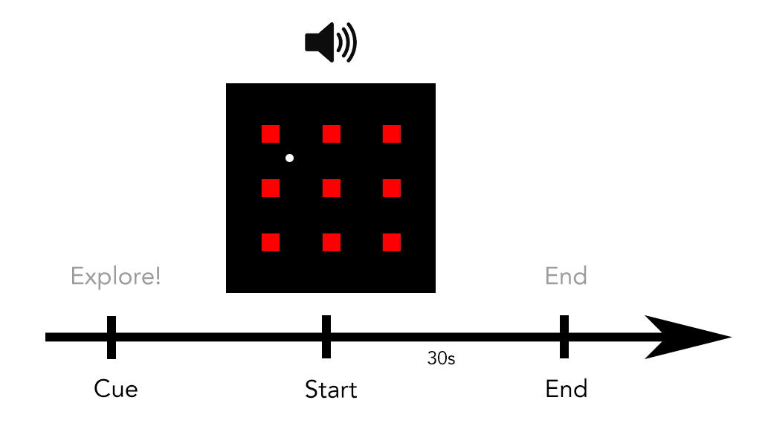
...
Acquisition trial structure (active condition)
Trial starts with cue “Explore!”
Participants move the gaze-controlled cursor and hear sounds
After 30s, acquisition trial ends and 6 test trials follow

Slide 7
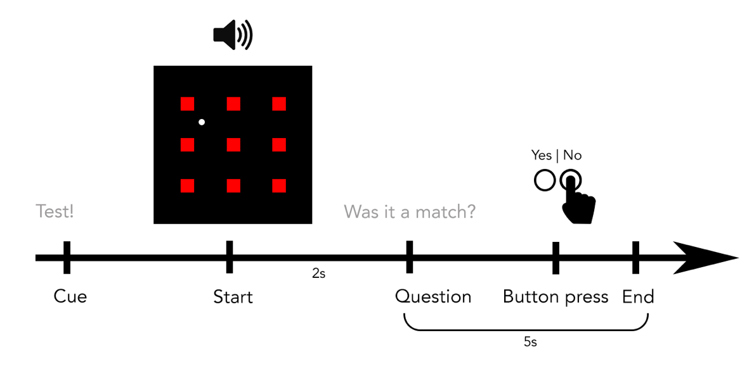
...
Test trial structure (both conditions)
Trial starts with cue “Test!”
Cursor moves independently and sound is played
Sound can be congruent or incongruent (another of the 8 sounds of the set)

Slide 8
...
Acquisition trial structure (passive condition)
Trial starts with cue “Observe!”
Participants watch a self-moving cursor that creates sounds
After 30s, acquisition trial ends and 6 test trials follow
Observe!

Slide 9
...
Sound stimuli
8 movement directions are associated with 8 different sounds: up, down, left, right, up-right, up-left, down-right, down-left
Sounds are consonant-vowel syllables: /ba/, /pi/, /fu/, ... generated with Google Text-to-Speech and edited in Praat (pitch is monotone and varies between 90Hz and 300Hz)
Each set of 8 sounds is learned in 6 rounds of acquisition (contingency blocks); there are 10 contingency blocks (i.e. 80 sounds) in total

Slide 10
...
Structure of experiment
1 acquisition trial is followed by 6 test trials
Contingencies between movement directions and sounds repeat 6 times (i.e. 6 exploration trials and 36 test trials per contingency block)
After the 6th acquisition+test unit of a contingency, the contingencies are changed: Movement directions will be associated with a new set of 8 sounds now

Slide 11
...
EEG recording
Number of electrodes: 64+4
Reference: nose
Ground: between Fz and FPz
M1, M2
EOG (unipolar configuration):
  HEOG
    1. Left
    2. Right
  VEOG
    3. up
    4. down

Slide 12
...
Analysis
Behavioural data:
  %Correct by block (1+2, 3+4, 5+6), “learning curve”
  %Correct in active vs. passive condition
EEG:
  ERPs of congruent vs. incongruent test sounds during early or late stages of acquisition
  ERPs (congruent/incongruent) in active vs. passive condition: acquisition sounds and test sounds!

Slide 13
...
Hypotheses
Behavioural:
  Active acquisition improves %Correct in test trials earlier (faster learning)
EEG:
  Test sounds
    N1 attenuation for congruent, effect increases with LS (Schröger et al., 2015)
    N2 for incongruent as deviance detection, increased with LS (based on IluAg?)
    Stronger N1 or N2 effects in agent than in observer condition
    P3a for deviants as novelty-orienting response, increased for self-generated stimuli (Kühn et al., 2011)
  Acquisition sounds:
    Agent vs. observer: N1 and P2 attenuation (Timm et al., 2016) (also unspecific motor effects?)
    There are no deviant sounds in acquisition trials, but we can analyse acquisition sounds in agent vs. observer blocks and by acquisition phase: LS1, LS2, LS3
    Stronger predictions in later LS, which could reflect in attenuated ERP responses

Slide 14
...
Number of trials per condition
Test sounds: 6 per block, 10*6 per contingency, 10*10*6 per condition (active and passive) → 600/condition
Of those 600 total test trials per condition, congruent/incongruent → 300/congruency per condition
Learning stages: In each contingency, we have three learning stages (early, middle, late); 6 per block, 2*6 per learning stage, 10*2*6 per condition → 120/learning-stage
Of those 120 test sounds per learning stage → 60/learning-stage and congruency
Estimated total duration: 240min

Slide 15
...
Behavioural pilot
2 contingency blocks with 6 acquisition-test blocks each (12 acquisition trials and 72 test trials in total)
Pilot participants learn two different sets of contingencies between movements and sounds
Cursor is controlled actively with the mouse of the computer

Slide 16
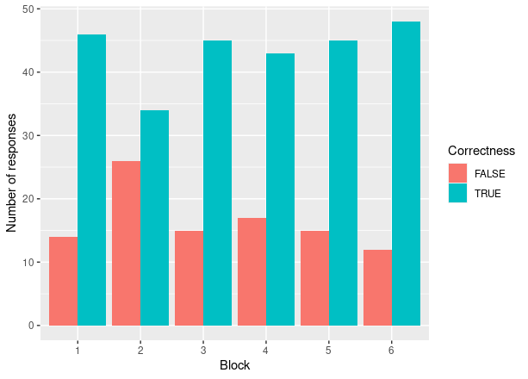
...
First behavioural results (n=5): Learning “curve”
No improvement visible during learning period of 6 blocks
Initial performance is already quite good
Maybe shorter acquisition trials?

Slide 17
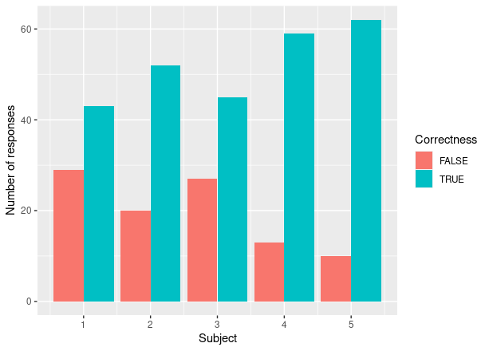
...
First behavioural results (n=5): Subjects
Similar tendency across subjects

Slide 18
...

